Slide 1
Welcome to: Azure Stack Meetup Event Hybrid Cloud The Future and the present...

Slide 2
Agenda
Introduction – (10-15 min)
Azure Stack Hybrid demo by Chris Black and Bailey Lawson – ~1h
Break – (10-15 min)
Secret guest speaker – (30-45min)
Kenny Lowe – AWS Outposts
Darren Small – What is the meaning of life?
Thanks – get drunk!

Slide 3




Event Hosts – Who are we?
Chris Black – Azure Stack Technical Authority – Nerd
Bailey Lawson – Azure Stack Engineer – Steve Jobs/Yeti
Kenny Lowe – Azure Stack MVP – Bus mechanic
Darren Small – Azure Stack Black Belt – Karate Kid

Slide 4
Few questions… ☺ - Show of hands
How many of you used Azure before?
How many of you used Azure Stack before?
How many of you are DevOps?
How many of you are using only Private or only Public cloud?
How many of you are using Hybrid cloud?

Slide 5
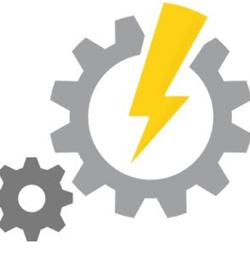





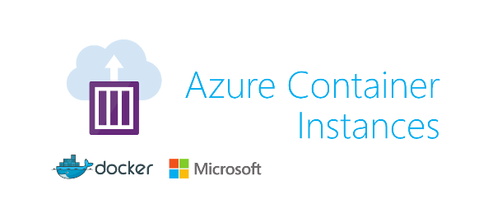


Azure Stack Hybrid demo - overview
Azure Traffic Manager

Slide 6
Azure Stack Hybrid demo – high level design
On-board new customer to Azure and Azure Stack.
Deploy Kubernetes cluster in Azure Stack and host a website there from Docker Container Registry image kept in Azure.
Deploy a website inside Azure Docker Container Group from Docker Container Registry.
Deploy Traffic Manager to host both endpoints.
Swap endpoints using Azure Automation Runbook.
Enjoy the power of Hybrid Cloud!!! – HAPPY AZURE STACKING! ☺

Slide 7
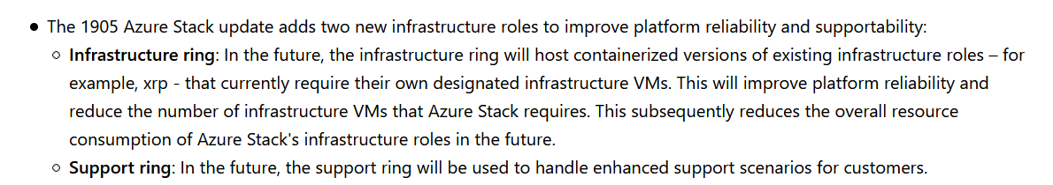
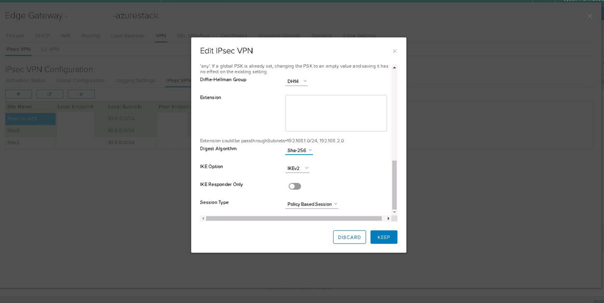
Azure Stack related interesting new things…
Microsoft discovered containers! – Azure Stack will be containerised! – see AZS-1905-ReleaseNotes
VMware vCloud Director enters XXI century! VPN gateway IKEv2 and SHA-256 is now configurable!
(vCloud Director version: 9.7.0.13634630)
Terraform supports Managed Disks in Azure Stack! See - Link
Windows Server 2019 on Azure Stack is now available!

Slide 9
Useful Links
My blog -> https://theblackcloud.tech/
Presentation Repo -> https://github.com/UKCloud/AzureStack
Knowledge Centre -> https://docs.ukcloud.com
Terraform -> https://www.terraform.io/docs/providers/azurestack/
MS Docs -> https://docs.microsoft.com/en-us/azure-stack/user/ https://docs.microsoft.com/en-us/azure-stack/operator/
Happy Azure Stacking!!! ☺☺☺☺☺

